Slide 1
Statistics with Spa ows
Lecture 12
Julia Schroeder
Julia.schroeder@imperial.ac.uk

Slide 2
ANalysis Of Variance – ANOVA
ANOVA
Testing for difference of variances between groups
One categorical variable as explanatory variable

Slide 3
ANOVA
Null-hypothesis: groups are equal

Slide 4
ANOVA
Null-hypothesis: groups are equal
Idea: variability among groups is larger than within groups

Slide 5
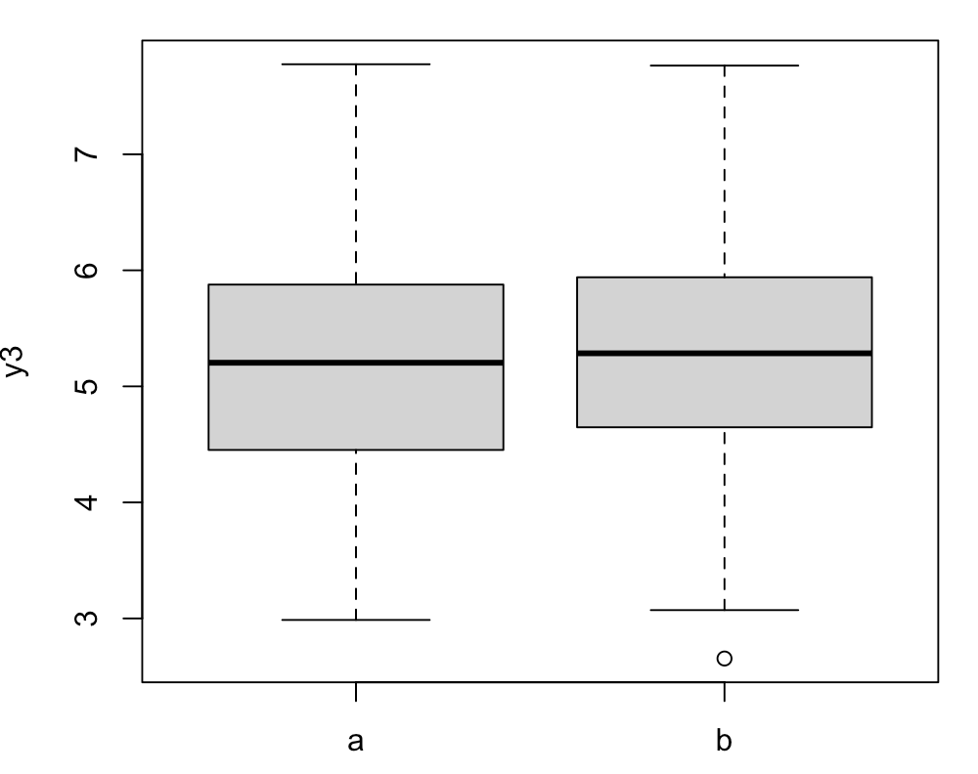
ANOVA
Hypothesis: variance among groups is larger than variance within groups
AG + WG = T
→ variance calculus rules

Slide 6
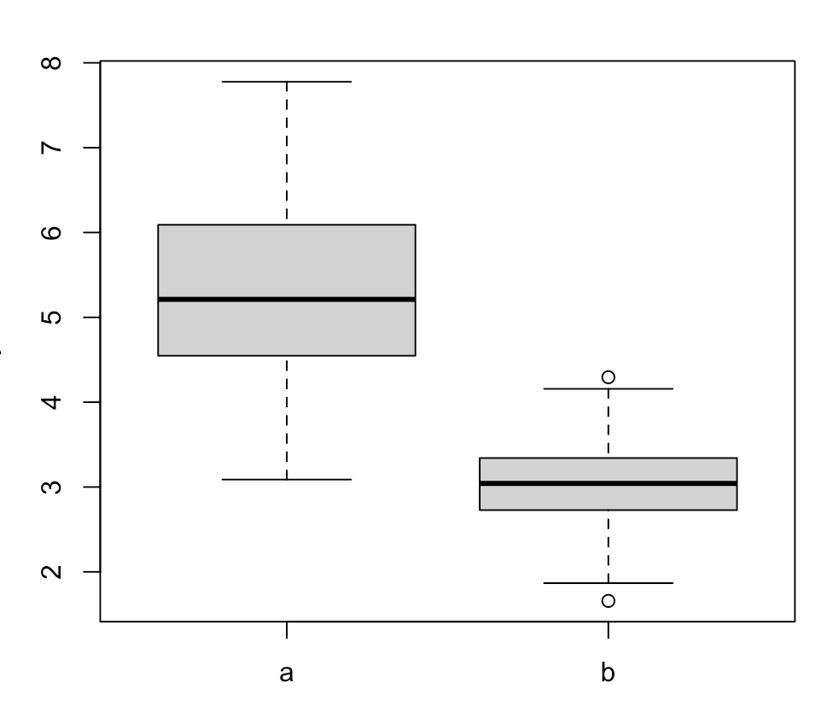
ANOVA
Hypothesis: variance among groups is smaller than variance within groups
AG + WG = T
→ variance calculus rules

Slide 7
ANOVA
So, it’s different from a t-test where we test for a difference in mean
We test for a difference in variances
But not between groups – instead, we look at the ratio of between group variance to total variance
From that we can infer that means differ, - but that’s an inference, not the actual test like a linear model or t-test

Slide 8
Ratio between group variance – total variance
Experiment:
Outcome variable, 3 treatments:
Testing for difference between treatments.

Slide 9
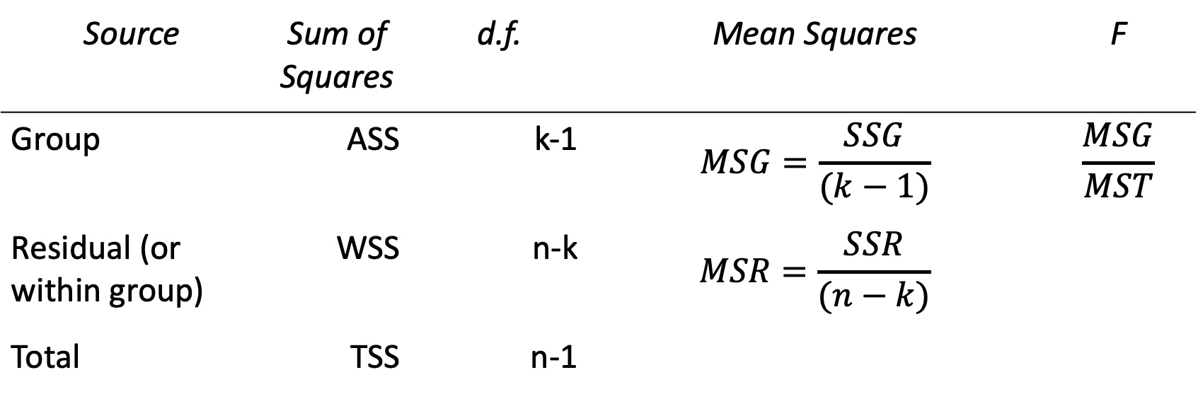
Anova
i | y | group | j | I,j
1 | 1.34 | A | 1 | 1,1
2 | 1.22 | A | 1 | 2,1
3 | 1.27 | A | 1 | 3,1
4 | 1.56 | B | 2 | 1,2
5 | 1.49 | B | 2 | 2,2
6 | 1.52 | B | 2 | 3,2
7 | 1.09 | C | 3 | 1,3
8 | 1.11 | C | 3 | 2,3
9 | 1.08 | C | 3 | 3,3
Source | Sum of Squares | d.f. | Mean Squares | F
Group | ASS | k-1 | $$MSG=\frac{SSG}{(k−1)}$$ | $$\frac{MSG}{MST}$$
Residual (or within group) | WSS | n-k | $$MSR=\frac{SSR}{(n−k)}$$
Total | TSS | n-1

Slide 10
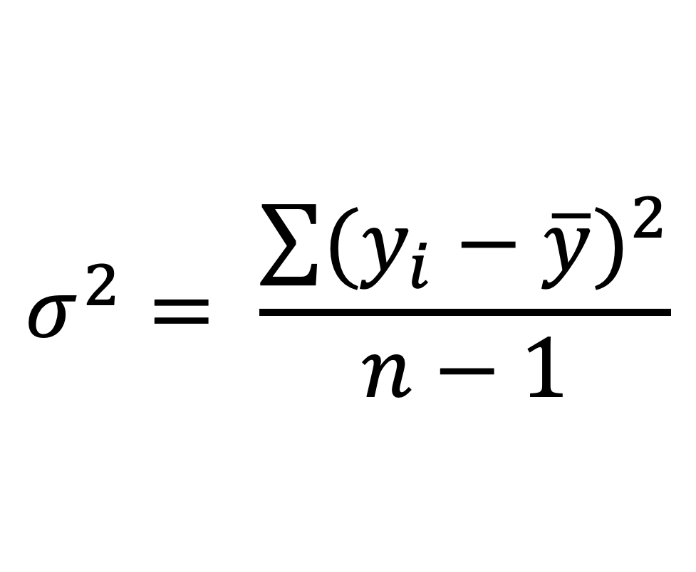
Variances – within and among groups
$$σ^{2}= \frac{\sum{{(y_{i}−\overline{y})}^{2}}}{n−1}$$
i | y | group | j | I,j
1 | 1.34 | A | 1 | 1,1
2 | 1.22 | A | 1 | 2,1
3 | 1.27 | A | 1 | 3,1
4 | 1.56 | B | 2 | 1,2
5 | 1.49 | B | 2 | 2,2
6 | 1.52 | B | 2 | 3,2
7 | 1.09 | C | 3 | 1,3
8 | 1.11 | C | 3 | 2,3
9 | 1.08 | C | 3 | 3,3

Slide 11
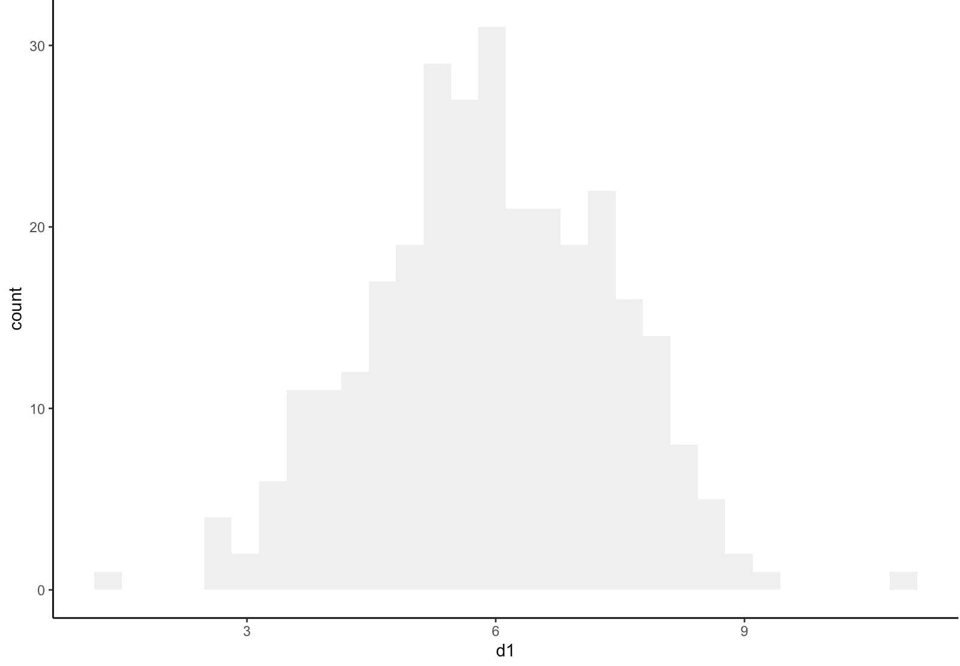
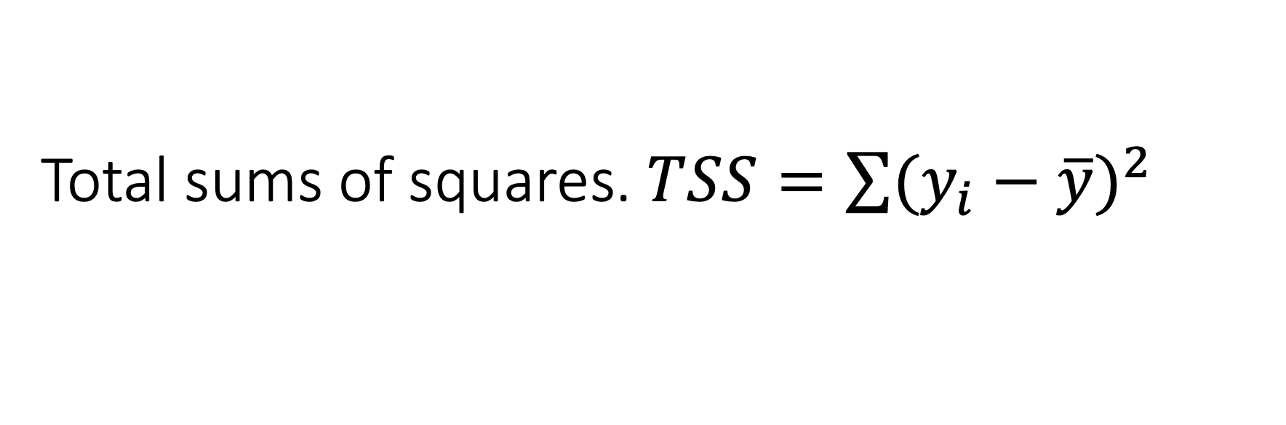
Total sums of squares. $TSS=\sum{{(y_{i}−\overline{y})}^{2}}$

Slide 12
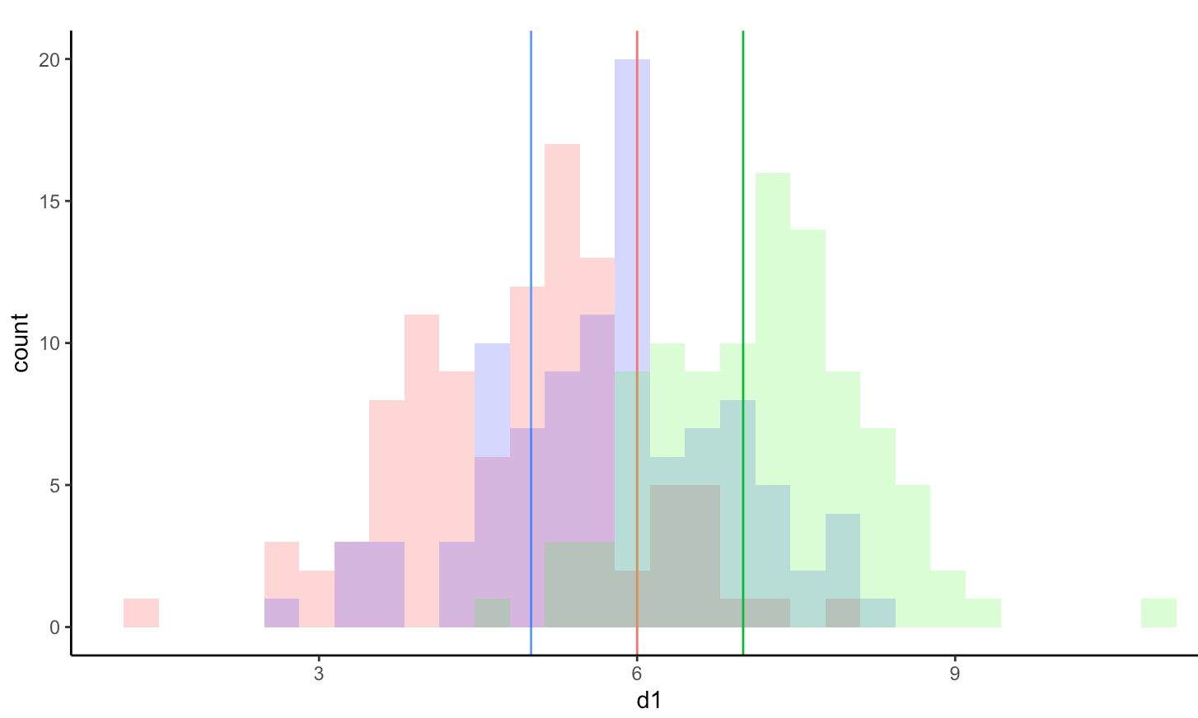
So we have groups..

Slide 13
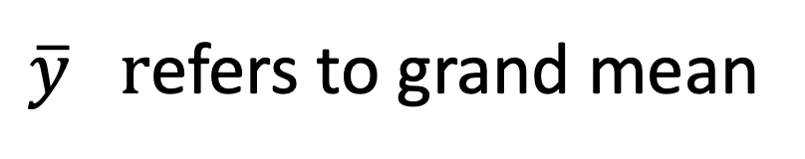
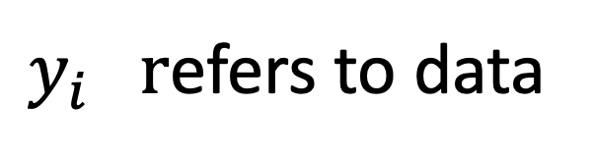
Notation
i | y | group | j | I,j
1 | 1.34 | A | 1 | 1,1
2 | 1.22 | A | 1 | 2,1
3 | 1.27 | A | 1 | 3,1
4 | 1.56 | B | 2 | 1,2
5 | 1.49 | B | 2 | 2,2
6 | 1.52 | B | 2 | 3,2
7 | 1.09 | C | 3 | 1,3
8 | 1.11 | C | 3 | 2,3
9 | 1.08 | C | 3 | 3,3
$y_{i} r$efers to data
$\overline{y} r$efers to grand mean

Slide 14
Notation
i | y | group | j | I,j
1 | 1.34 | A | 1 | 1,1
2 | 1.22 | A | 1 | 2,1
3 | 1.27 | A | 1 | 3,1
4 | 1.56 | B | 2 | 1,2
5 | 1.49 | B | 2 | 2,2
6 | 1.52 | B | 2 | 3,2
7 | 1.09 | C | 3 | 1,3
8 | 1.11 | C | 3 | 2,3
9 | 1.08 | C | 3 | 3,3
$y_{i} r$efers to data
$\overline{y} r$efers to grand mean

Slide 15
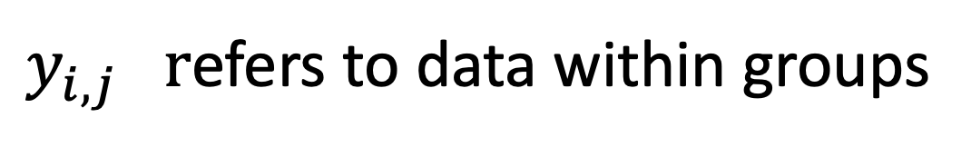
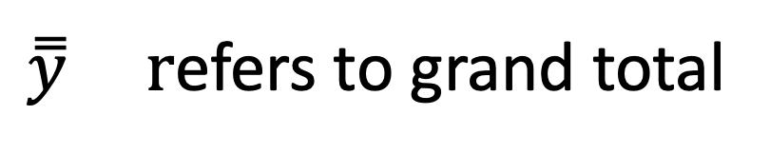
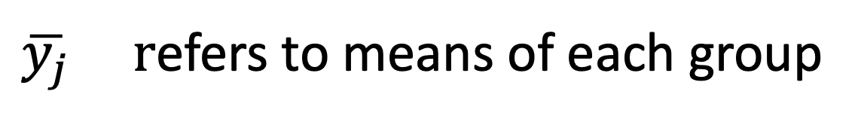
Notation
i | y | group | j | I,j
1 | 1.34 | A | 1 | 1,1
2 | 1.22 | A | 1 | 2,1
3 | 1.27 | A | 1 | 3,1
4 | 1.56 | B | 2 | 1,2
5 | 1.49 | B | 2 | 2,2
6 | 1.52 | B | 2 | 3,2
7 | 1.09 | C | 3 | 1,3
8 | 1.11 | C | 3 | 2,3
9 | 1.08 | C | 3 | 3,3
$y_{i} r$efers to data
$\overline{y} r$efers to grand mean
$y_{i,j} r$efers to data within groups
$\overline{y_{j}}$ $r$efers to means of each group
$\overset{̿}{y} r$efers to grand total

Slide 16
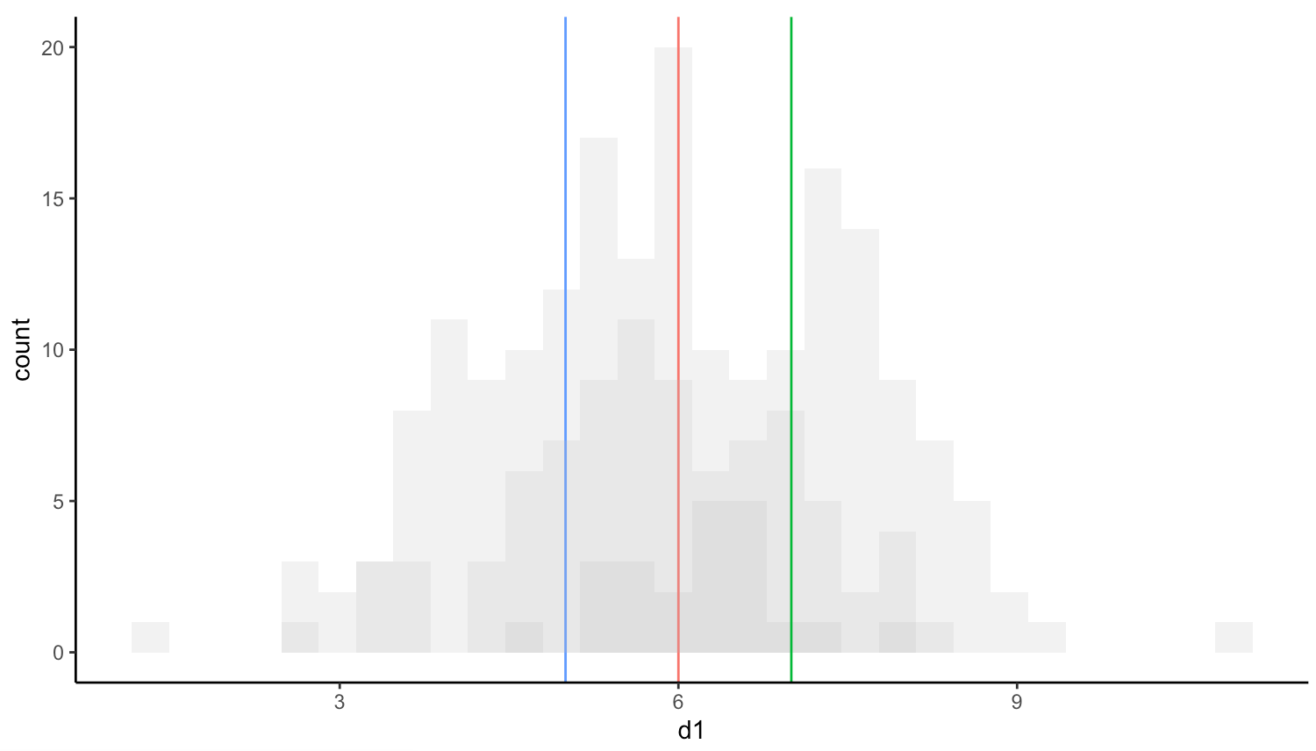
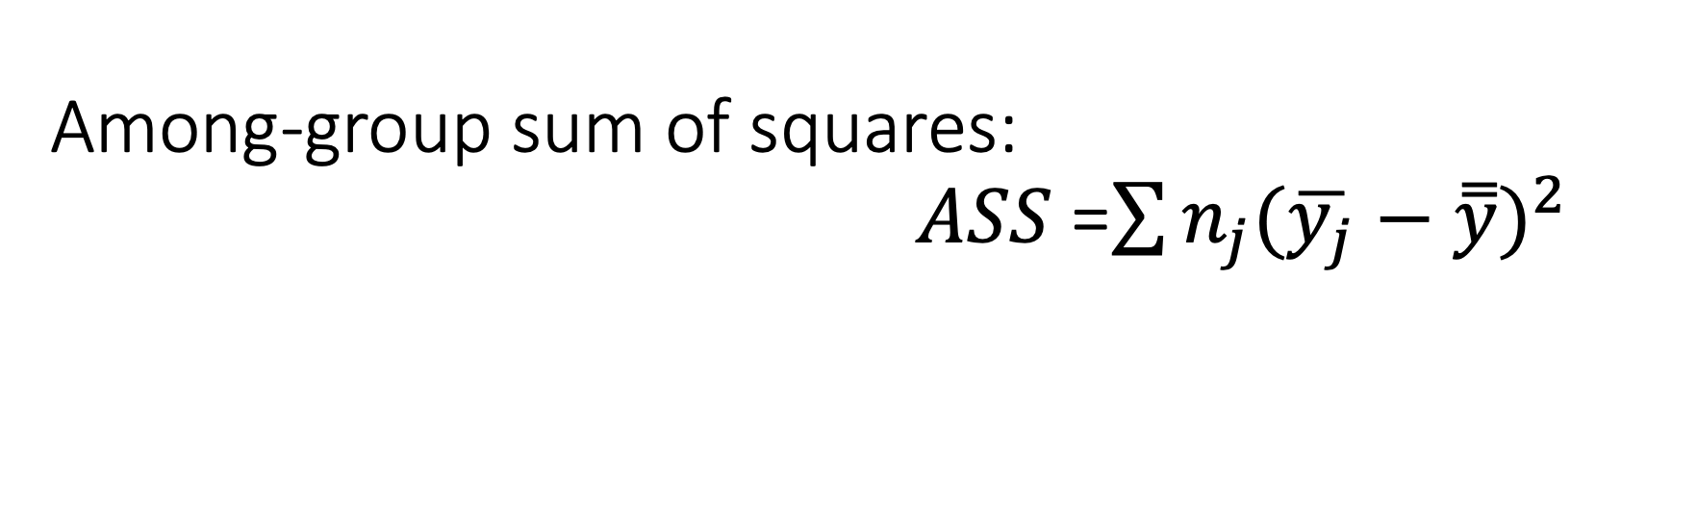
Among-group sum of squares: $ASS$ =$\sum{n_{j}{(\overline{y_{j}}−\overset{̿}{y})}^{2}}$
- Deviations of the means from the overall mean

Slide 17
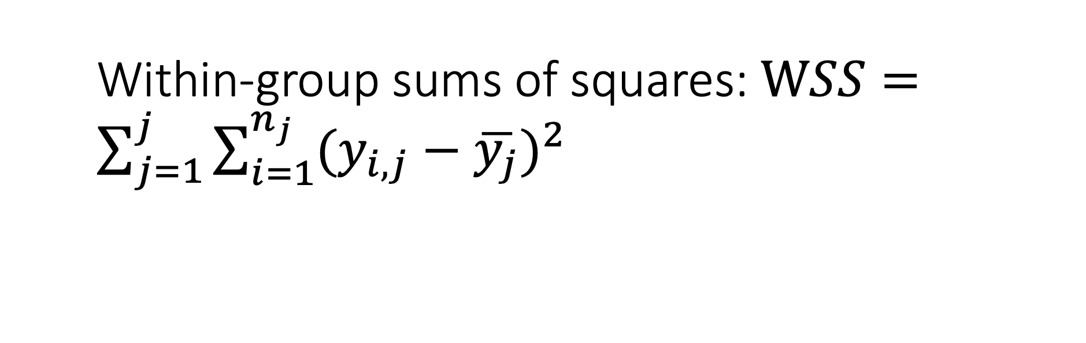
Within-group sums of squares: $WSS=\sum_{j=1}^{j}{\sum_{i=1}^{n_{j}}{{(y_{i,j}−\overline{y_{j}})}^{2}}}$

Slide 18
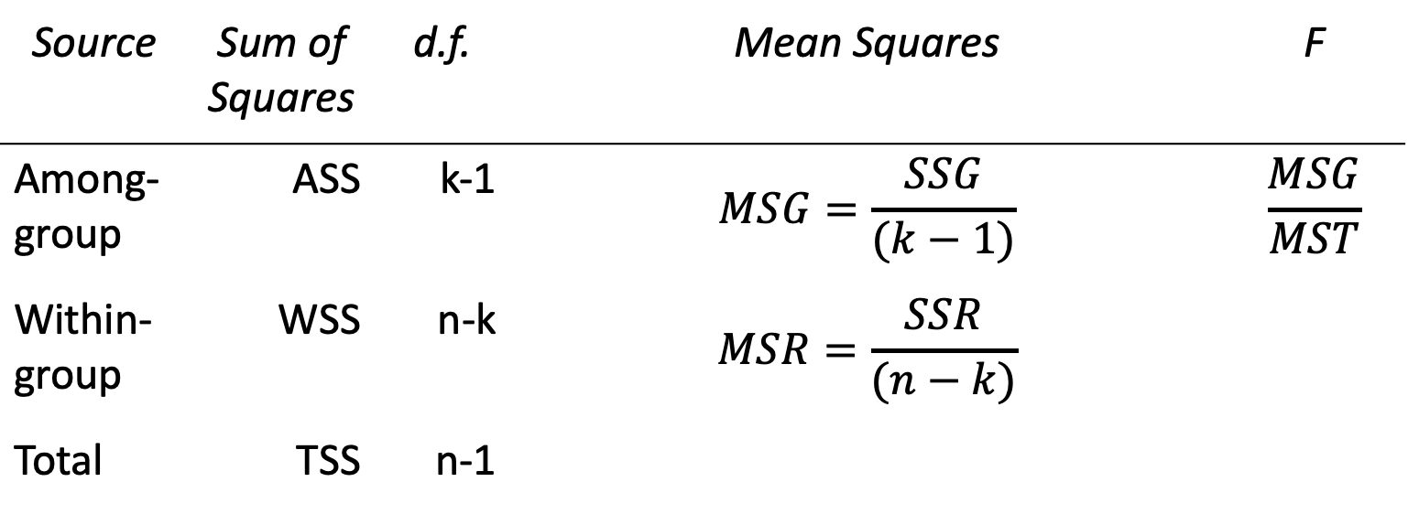
Source | Sum of Squares | d.f. | Mean Squares | F
Among-group | ASS | k-1 | $$MSG=\frac{SSG}{(k−1)}$$ | $$\frac{MSG}{MST}$$
Within-group | WSS | n-k | $$MSR=\frac{SSR}{(n−k)}$$
Total | TSS | n-1
Sum of squares among groups: ASS
Sum of squares within groups = residual: WSS
Total sum of squares: TSS = ASS + WSS
k = n of groups (length of j)
n = sample size (length of i)

Slide 19
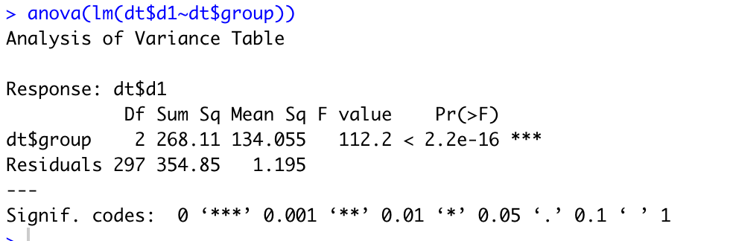
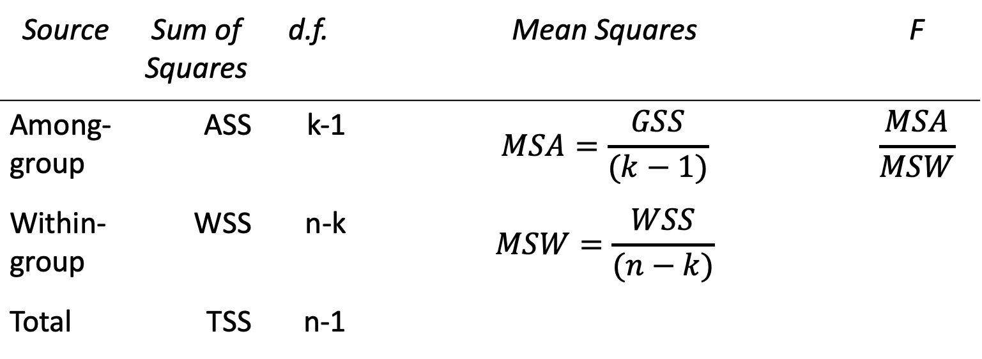
Source | Sum of Squares | d.f. | Mean Squares | F
Among-group | ASS | k-1 | $$MSA=\frac{GSS}{(k−1)}$$ | $$\frac{MSA}{MSW}$$
Within-group | WSS | n-k | $$MSW=\frac{WSS}{(n−k)}$$
Total | TSS | n-1
Interpretation:
There are differences between the means
We don’t know where or how much
→ post-hoc tests to see where

Slide 20
ANOVA:
A continuous response variable
A factorial explanatory variable with two or more levels
Provides secondary statistics only
Needs post-hoc testing for effect sizes and to find out which categories differ
Linear model
A continuous response variable
A continuous explanatory variable AND/OR a factorial explanatory variable
Provides primary statics
We get effect sizes (means) and precision of each level, thus can judge differences

Slide 21
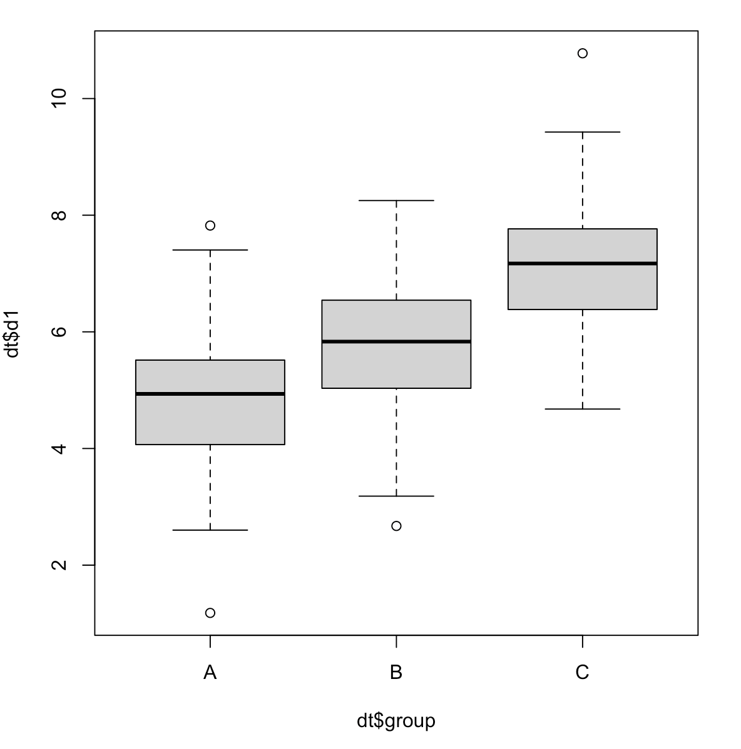
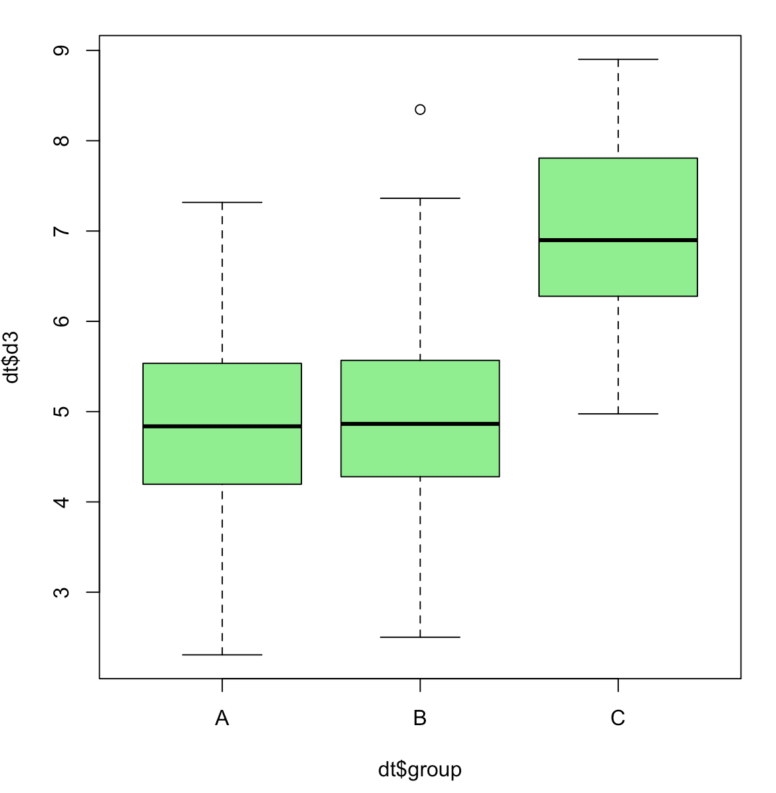
Battle: ANOVA vs linear model summary
Which one is more useful to describe the two results?

Slide 22
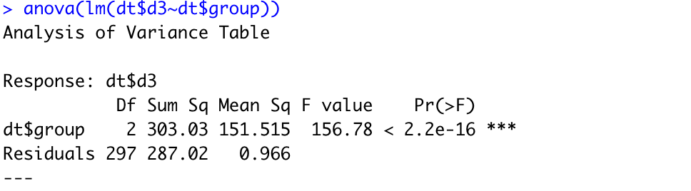
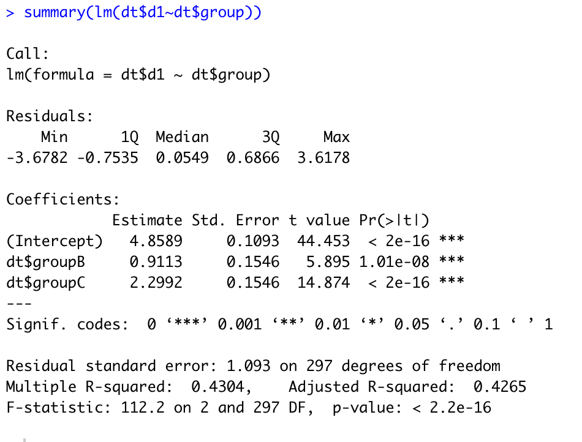
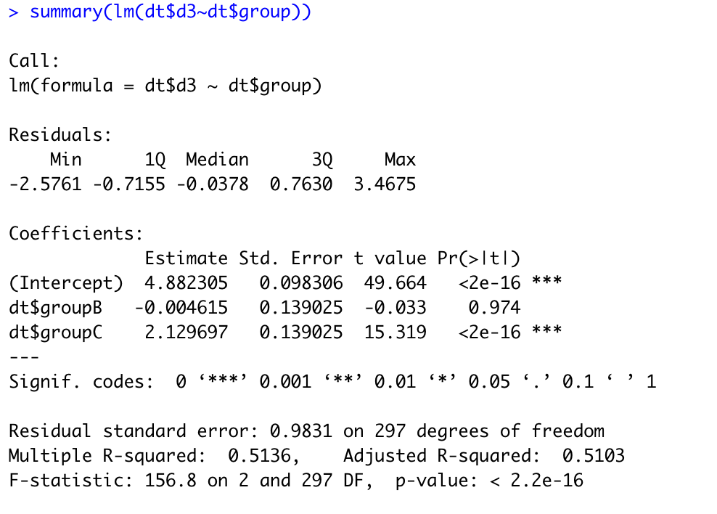

Slide 23
How to get anova table in R?

Slide 24
Anova vs linear model summary:
ANOVA is calculated from results of a linear model in R
ANOVA *is* a linear model, just a substandard way to report it
Because we only get secondary statistics (F)
MSSs provide information about variance (somewhat primary)
Linear model summary provides primary statiscs
And F-statistics
But information about variance is missing (but residual descriptives)

Slide 25

So, why the hype about ANOVA?
MSs are less computationally intensive calculate than model estimates
40-50 years ago you’d either do your calculations by hand (with a pocket calculator)
Or use hole punch cards

Slide 26
https://www.youtube.com/watch?v=KG2M4ttzBnY
Need to punch data and code
Model estimates more computationally intensive (weeks!)
More punching – more room for error
So, an iterative approach was useful – if not significant no need to put in the extra work
ANOVA today is more of a relic, habit, tradition
Use linear models instead!

Slide 27
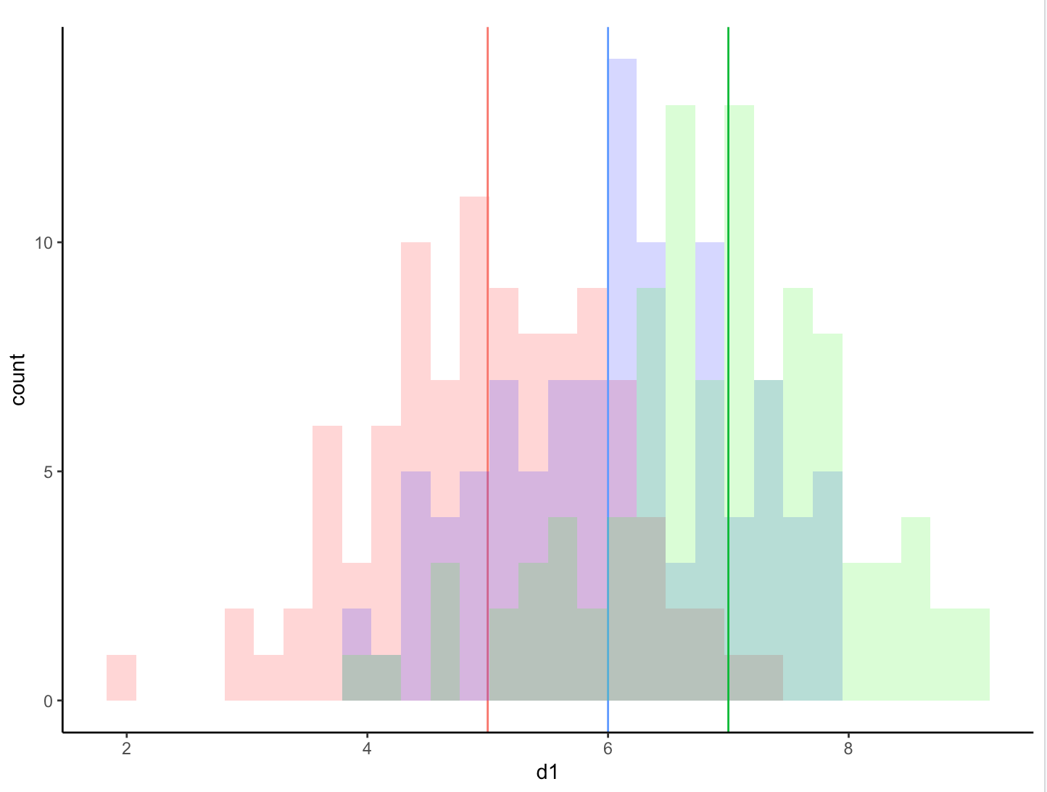
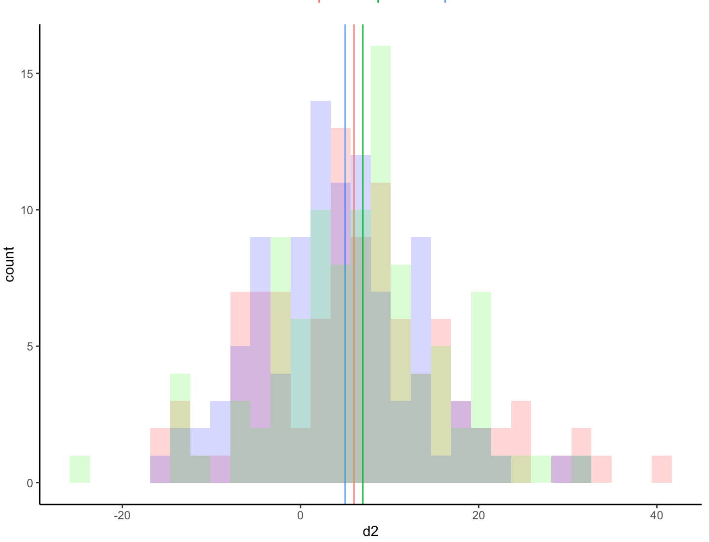
ANOVA is not really about means, it is an analysis of variances:
Same means
Different variances

Slide 28
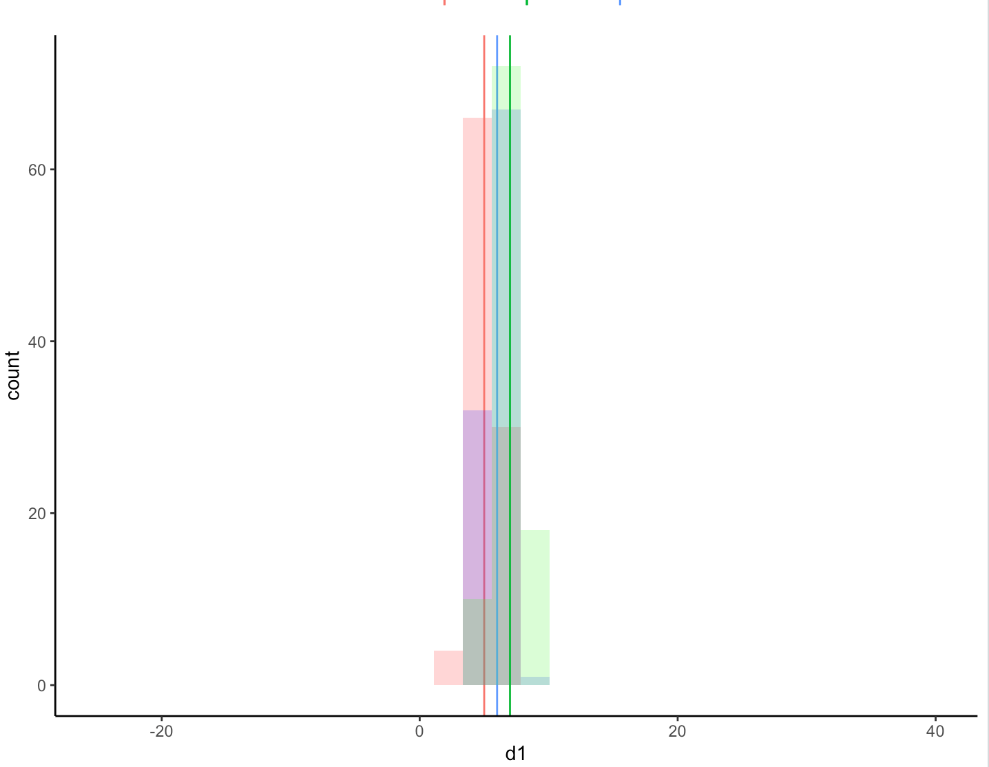
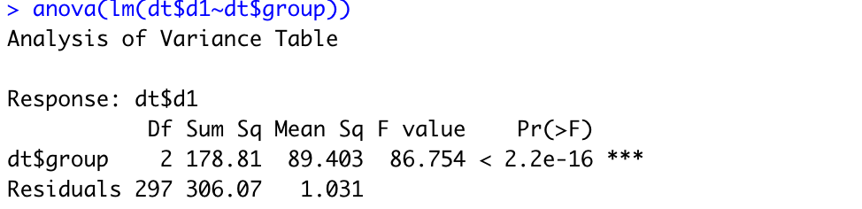
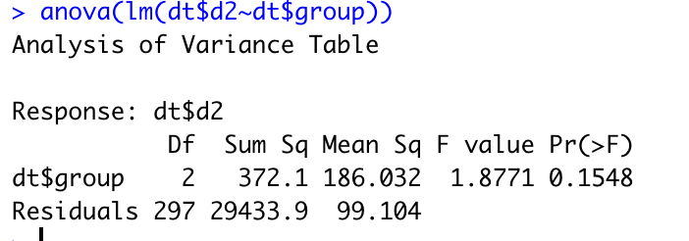
Variance between groups < variance within groups:
89 > 1
-> differences between groups
Variance among groups > variance within groups:
186 > 99
-> no differences between groups

Slide 29
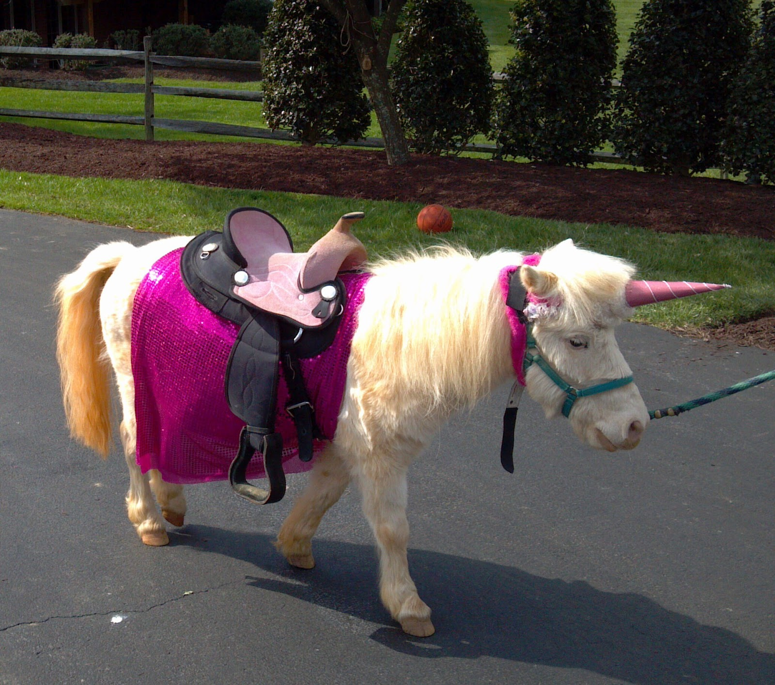
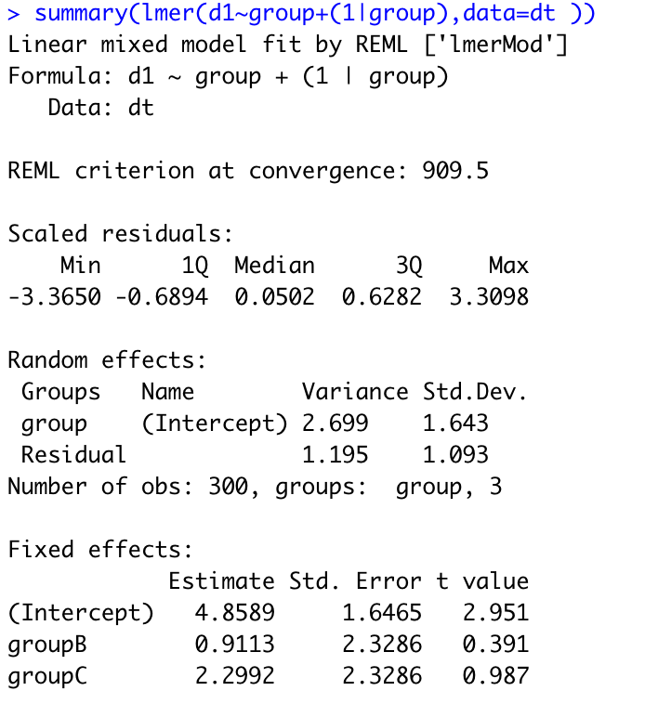
But what if we want to know about variances and mean estimates?
Linear mixed models estimate variance components and fixed effects simultaneously!
Among group variance
Within group variance
Total variance:
Va + Vw = Vt
=3.9
This Photo by Unknown Author is licensed under CC BY

Slide 30
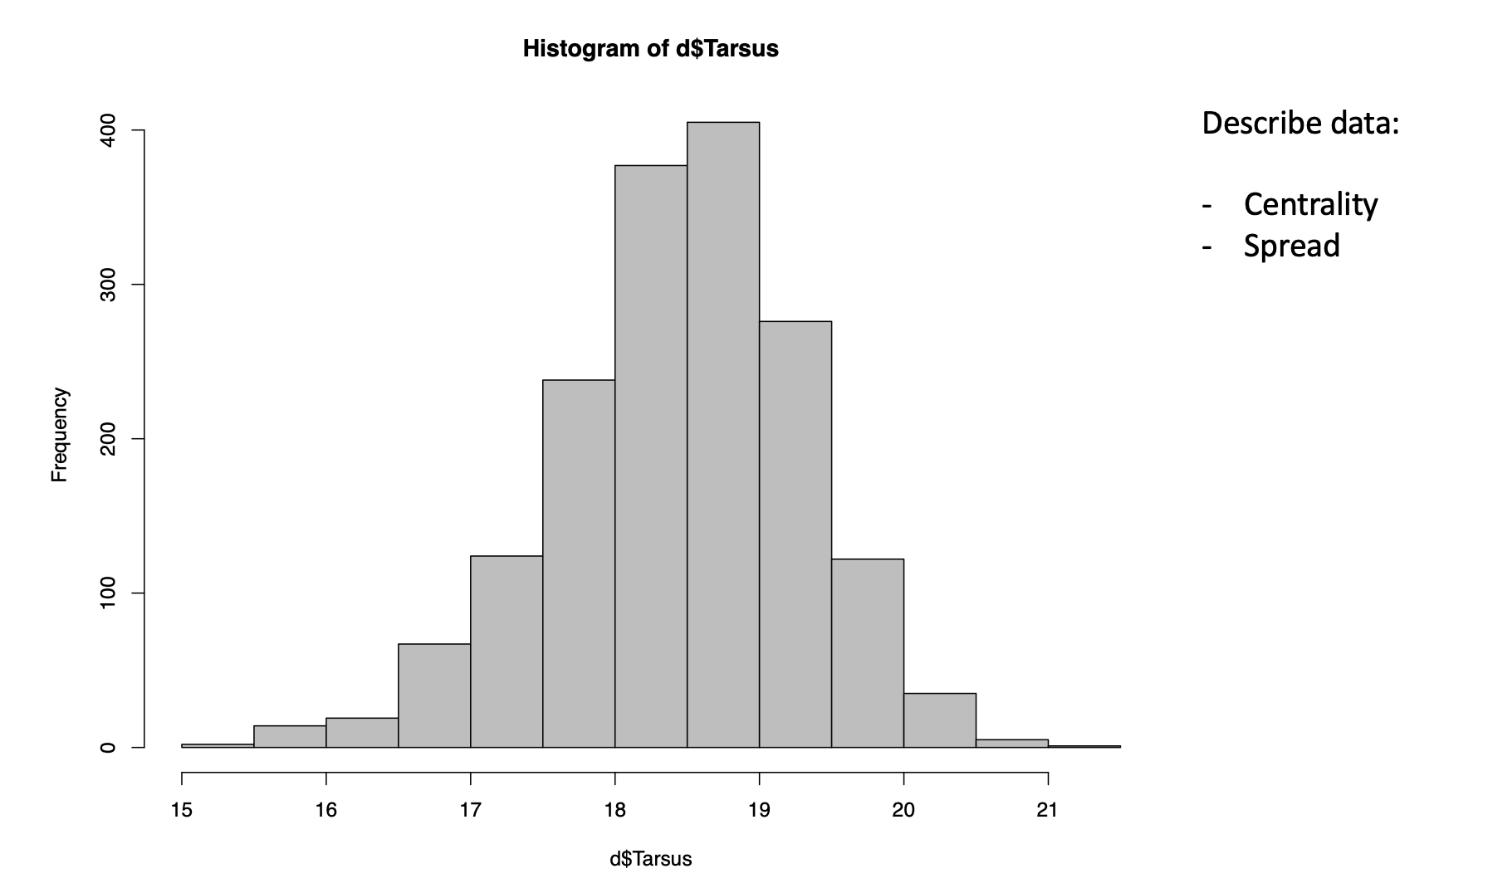
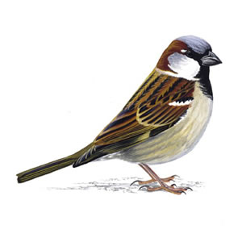
We’ve come full circle:
Linear mixed models estimate variance components and fixed effects simultaneously
Linear mixed models estimate spread and centrality simultaneously

